Slide 1
Space Settlement

Slide 2
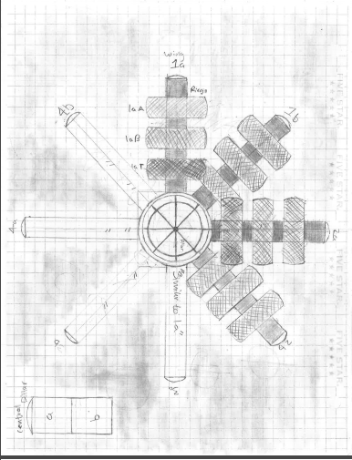
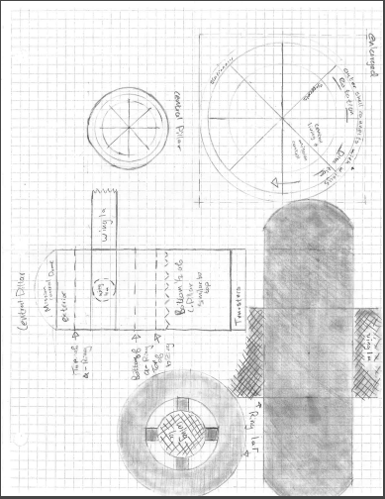
Outside of the Space Raider

Slide 3
Fuel
Origami Solar Panels
Fuel can be stored within batter-like containers that can be used and re-used every time.
The fuel for the fusion rocket is plasma
Alpha particles can be useful for propulsion and the ships electricity
Scientists are having trouble trying to find a way to keep the fusion plasma in a magnetic field

Slide 4
Energy
The storage could be in battery like containers, that could be used at a later date or anytime
Fusion Engine
  A fusion powered spacecraft is designed to recreate the same types of high- temperature reactions that occur in the core of the sun. That energy would be expelled from the engine to provide a huge amount of thrust.
The sustain fusion reaction the plasma must be confined, and the most widely studied configuration for terrestrial fusion is the tokamak, or a form of magnetic confinement fusion.
  Tokamaks weight a great deal, so the thrust to weight ration would seem to be too great.

Slide 5
Electricity
We will be using solar energy is to employ sunlight
A photo electrochemical cell- or solar cells that produce electrical energy or hydrogen in a process similar to electrolysis of water
  This would use solar energy to split water into hydrogen and oxygen gases which can be stored as fuels
The storage could be in battery like containers, that could be used at a later date or anytime

Slide 6
Electricity continued…
We would use multiple methods for generating electricity, not just solar panels.
Water dams use generators and turbines to power electricity, we would use something similar to water dam technology.
  The water for the turbines would come from our waste water. Parts of the waste water would be purified for re-use.
We would harvest the methane from the cow feces aboard the ship

Slide 7
Basic human nutrition
Fibers
Proteins
Carbohydrates
The best sources for fibers are whole grain foods, fresh fruits, legumes, nuts, and vegetables. Fibers reduce the risk of heart diseases.
Proteins are the basis of many body structures. Each molecule is composed of amino acids. Amino acids cannot be absorbed or is either metabolized or excreted
The best sources for carbohydrates are whole grains, vegetables, fruits, and beans
They promote good health by providing vitamins, minerals, and fiber

Slide 8
Foods
Meats
Nuts
Vegetables
Fruits
Fish
Poultry
Almonds
Peanuts
Lettuce
Squash
Potatoes
Spinach
Carrots
Rice
Bananas
Apple
Berries
Watermelon
Oranges
Prunes

Slide 9
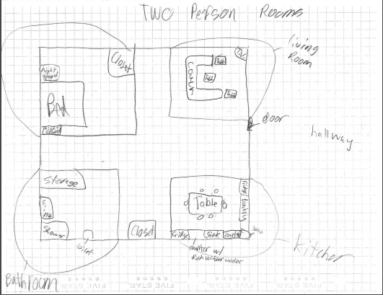
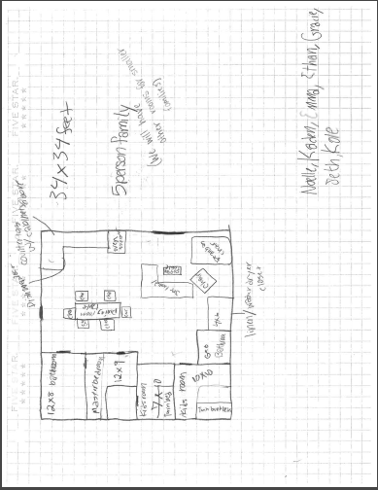
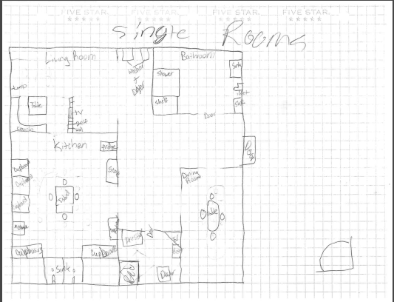
Living quarters
The living quarters with contain one master bedroom with a bathroom, a dining room, fully functioning kitchen containing a dishwasher, fridge, stove, microwave, and freezer. This room also contains a living room with a 3 person couch and 42-inch flat screen TV. It will come with a washer and dryer and closet.

Slide 10
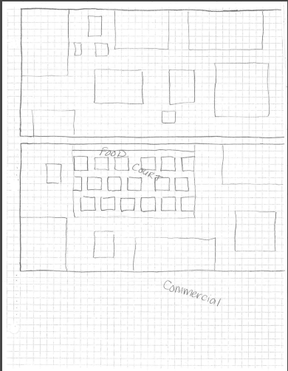
Commercial
The commercial area will be a series of buildings and businesses surrounding a food court with many restaurants and a series of grocery stores. The restaurants including In and Out, Hu Hot, Chick-Fil-A , Panda Express, McDonalds, Subway, KFC, Buffalo Wild Wings.

Slide 11
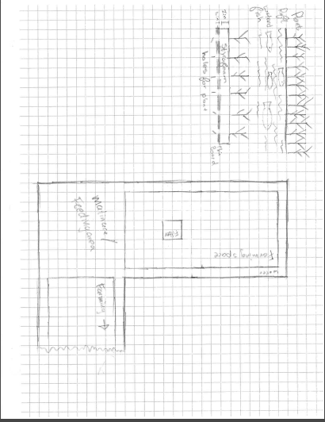
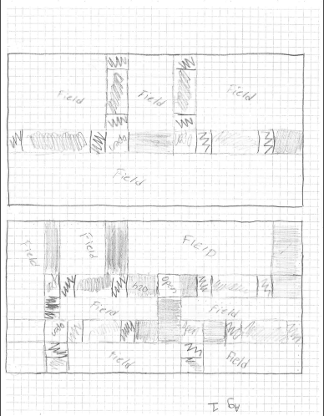
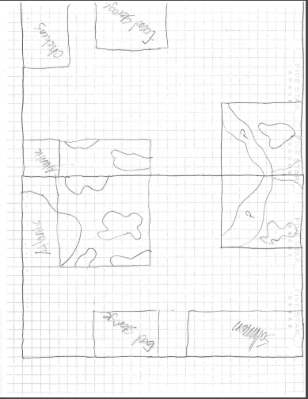
Agriculture Area
Our agricultural side of the ship will include a series of fields and channels of water. There will be a field dedicated to a certain crop and will act as an irrigation system. There will a series of ponds containing fish and marine life.

Slide 12
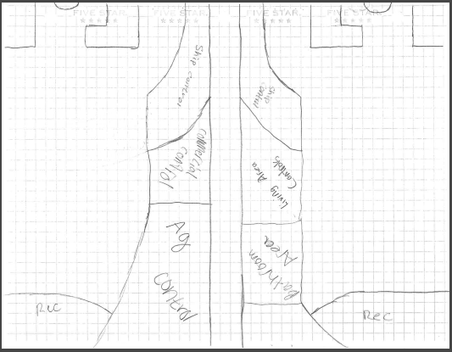
Command Center
The command center is where all the controls are. Different specialist will control each area of the ship as well as monitor closely in the case of mistakes. There will be a series of stations dedicated to each district

Slide 13
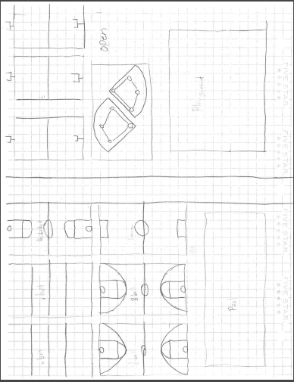
Recreational Area
The recreational area consists of full-size football fields, soccer fields, tennis courts, basketball courts, baseball fields, volleyballs courts, and a pool. Some other cool things we have a bowling alley, a laser tag area, and a trampoline park. There are a bunch of exciting things available to do on our ship. For example we have a bunch of sports you can play.

Slide 14
Kids Recreation
There are many playgrounds located throughout our ship. The kids will be required to exercise and stay in shape. They will have to do chores and other things. The kids will have designated areas to themselves so they do not interfere with adults and the older kids.

Slide 15
School
There will be online courses for school activities. The kids will still have a full learning experience. The kids will use a website to turn in assignments, quizzes, and tests. The teachers will hold virtual office hours for any questions the students.

Slide 16
Industrial
We will have a workshop for the bicycles and scooter repair and various other repair for things on the ship

Slide 17
Transportation
The people of the ship shall use bicycles, electric scooter for long distance.
Otherwise people will walk

